Slide 1
Data Science Project Life Cycle
Marlabs

Slide 2
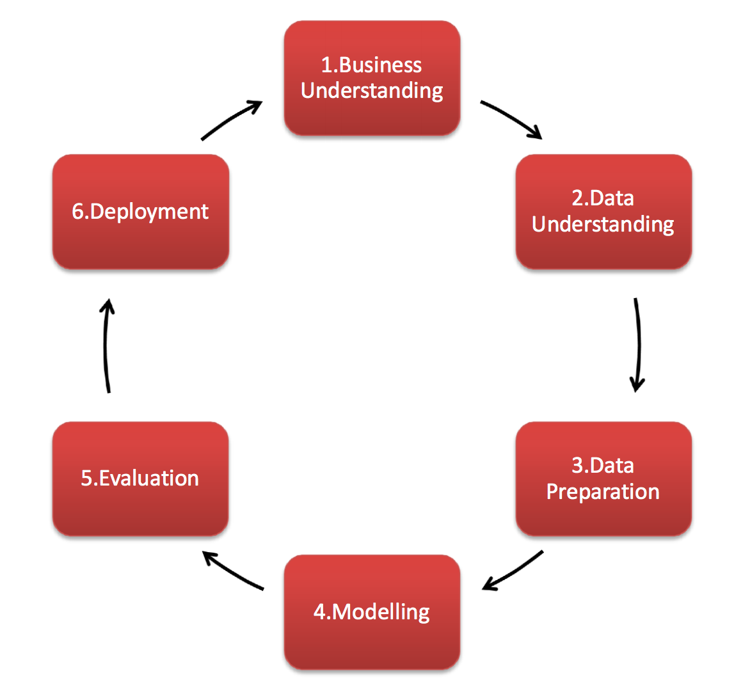

Slide 3
1. Business Understanding
Identify type of problem
Identify key people within your organization and outside. (domain expert -> feature selection)
Get specifications, requirements, priorities, budgets
How accurate the solution needs to be? -> Benchmark ->
Built internally versus using a vendor solution
Vendor comparison, benchmarking
….

Slide 4
2. Data Understanding
Extract sample data; discuss fields to make sure data is understood by you
Perform EDA (exploratory data analysis)
Is quality and fields populated consistent over time?
How to improve data quality moving forward
Data Source? SQL, web-scripting, internal data source or external
Do I need to create database?
How granular?
Which tool do I need (R, Excel, Tableau, Python, Spark)
Data mining: is the process of gathering your data from different sources.

Slide 5
3. Data Preparation
What fields should be captured?
How much historical data?
Do we need real time data?
Do we need experimental design?
Data Cleaning.
Data Wrangling: is the process of cleaning and unifying messy and complex data sets for easy access and analysis.
Features Selection.

Slide 6
4. Modeling & Evaluation
Define the problem
Split the input data into a training data set and a test data set. (Validation datasets -> hyperparameter tuning)
Build the models by using the training data set.
Evaluate the training and the test data set. Use a series of machine-learning algorithms.
Determine the “best” solution to answer the question by comparing the success metrics among alternative methods. (Evaluation Metrics -> regression, classification) -> document
Optimize the algorithms.
Question: what is the hyperparameters?

Slide 7
5. Deployment
Deploy the models
Reports
Visualization dashboards
Need to create an API to communicate with other apps?
Cooperating with UI team?

